Slide 1

IST 659 - PROJECT PRESENTATION
SYRACUSE UNIVERSITY DEPARTMENT OF PUBLIC SAFETY
- Rashika Singh

Slide 2

BUSINESS PROBLEM
There are student employees who work for Security of residential halls
In certain case where a student wishes to drop a shift, he must visit the office and enter his shift in the sub-book which is maintained for shifts
The entire process consumes time and is problematic when a person is unable to visit the office
This is a difficult task for both the employees and the managers

Slide 3

SOLUTION
The project creates an automated system for maintaining the shift schedule for managers and employees through a database
An account holder can be an employee or a manager
The database allows an employee to add, drop, pick and view his schedule
The manager can use the database to give approval to the employee dropping his shift and supervising over the shifts

Slide 4
DATA QUESTIONS
How many employees are working at a hall?
What are the shift timings for an employee?
How many employees are working at a hall at a time?
What are the number of hours an employee is working?
Is the reason for dropping a shift valid?
Has the student arrived for his shift?
Is the student receiving the pay for the number of hours he is working?
Has the person who picked up the shift arrived for the shift?

Slide 5

DATABASE
Account
Residential Halls
Employee
Manager
Employee Schedule
Employee Shift
Employee Hall
Dropped Shift
Picked Shift
Notes:
Account is the type of user and his details
Residential Halls is the description of the halls
Employee mentions unique Id for employee
Manager mentions unique Id for manager
Employee Schedule is the schedule for the employee
Employee Shift is the shift schedule for halls
Employee hall is the hall the employee is working at
Dropped shift is the shift the employee has dropped
Picked shift is the shift the employee has picked

Slide 6
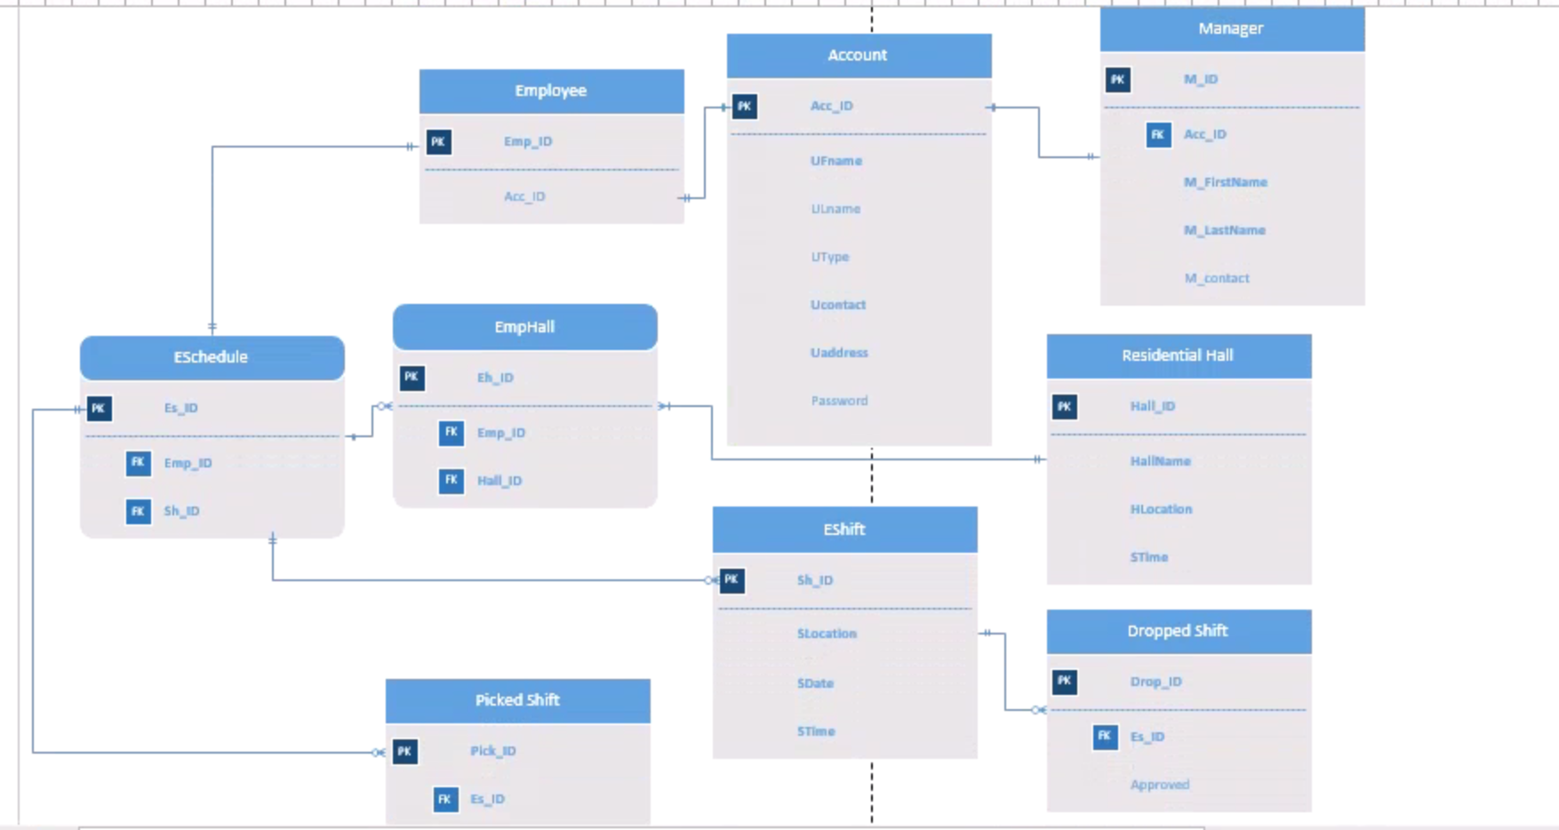
ERD DIAGRAM

Slide 7
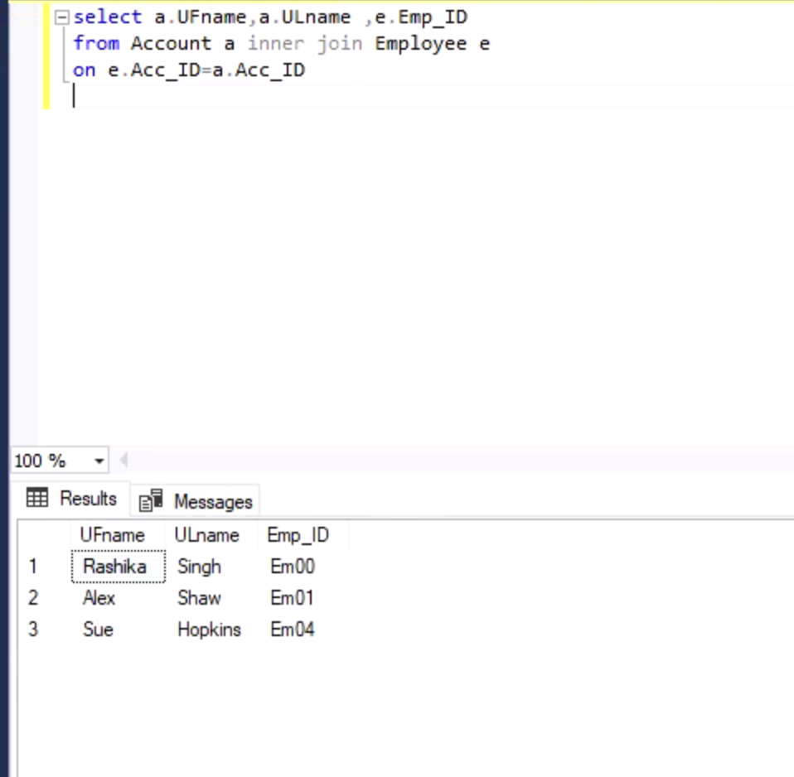
DATA QUESTIONS
Display employee ID and details

Slide 8
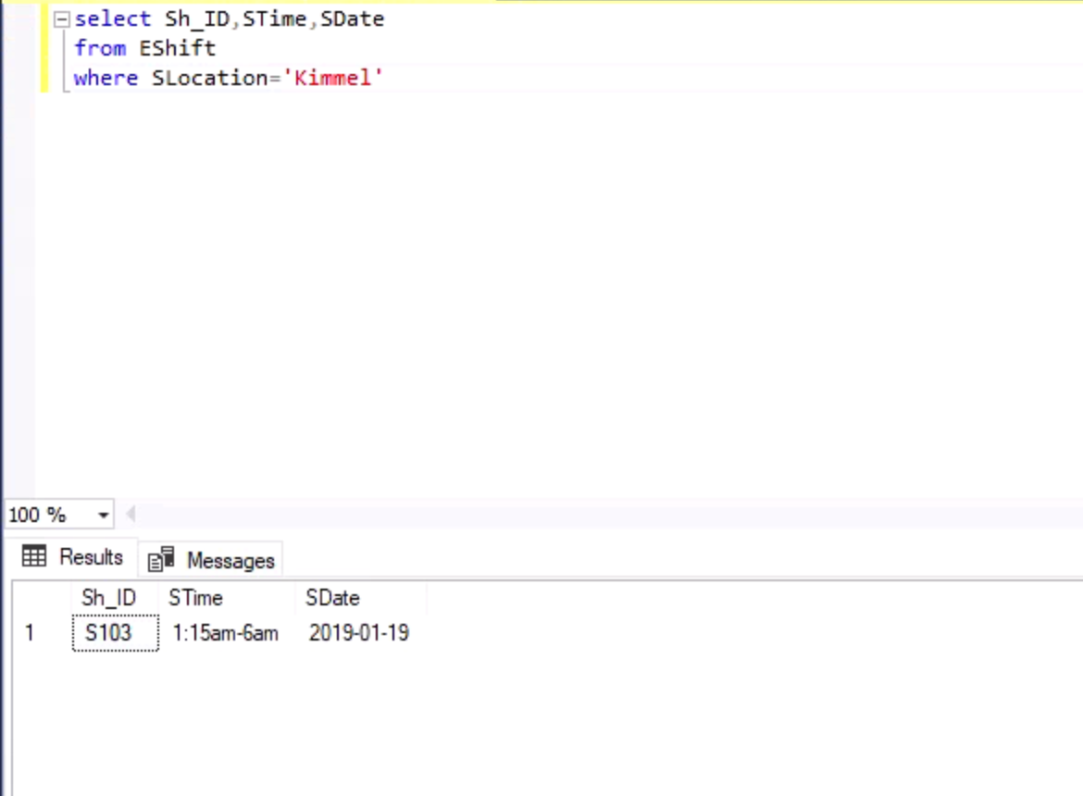
DATA QUESTIONS
Display the shifts filtered by location

Slide 9
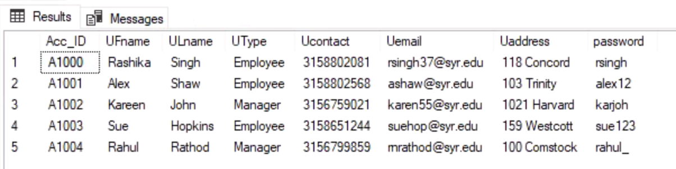
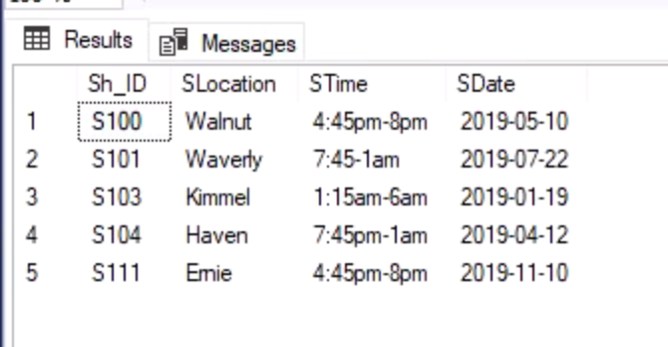
SAMPLE OF DATABASE
Account
EShift

Slide 10
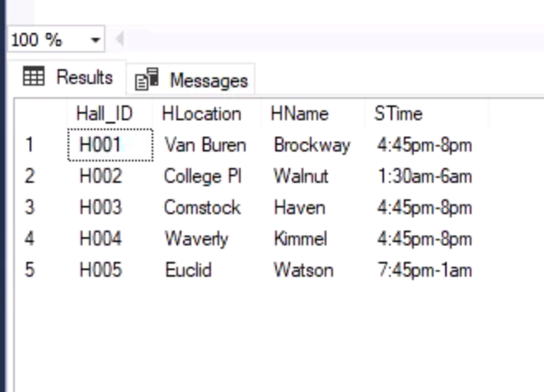
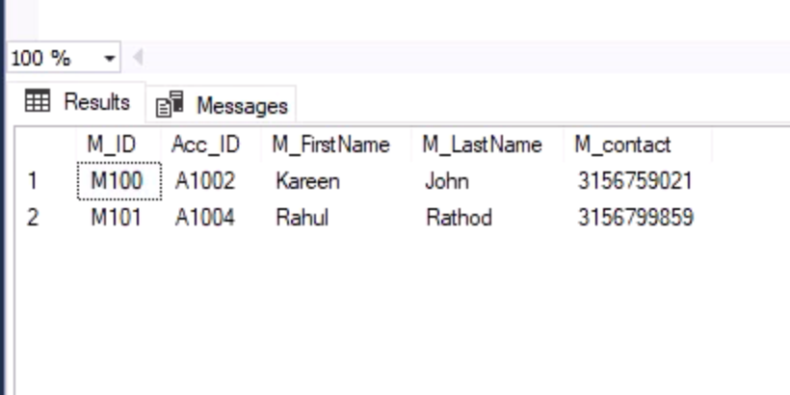
SAMPLE OF DATABASE
Residential Halls
Manager

Slide 11
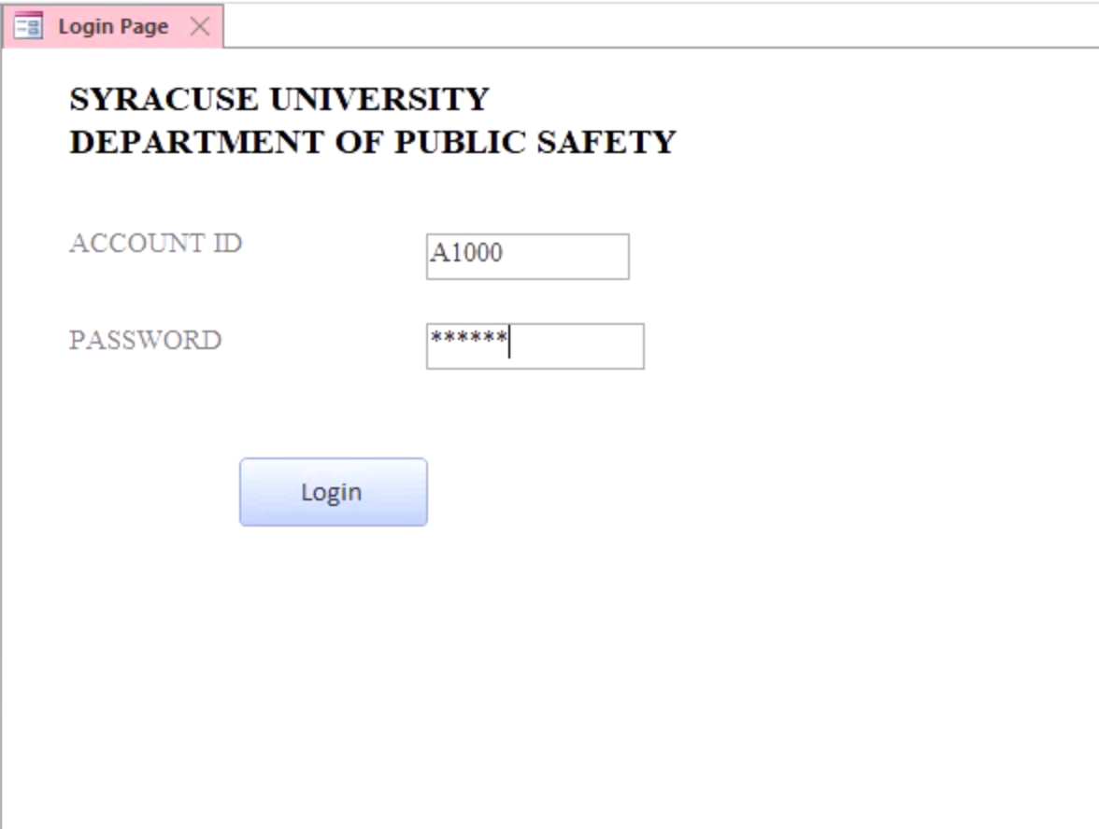
FORMS
Login page

Slide 12
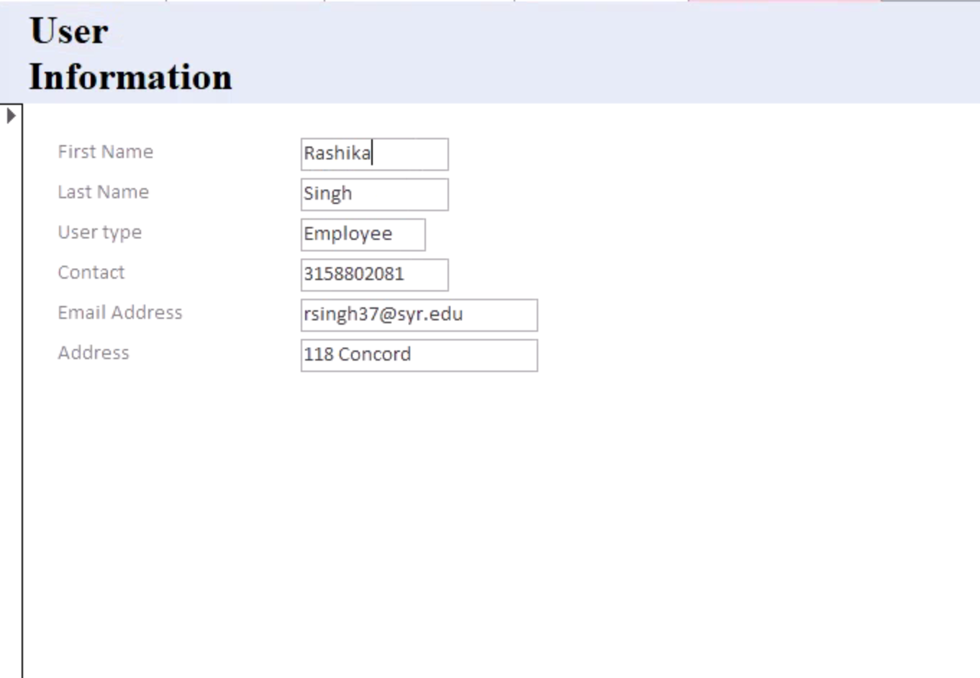
FORMS
User Information

Slide 13
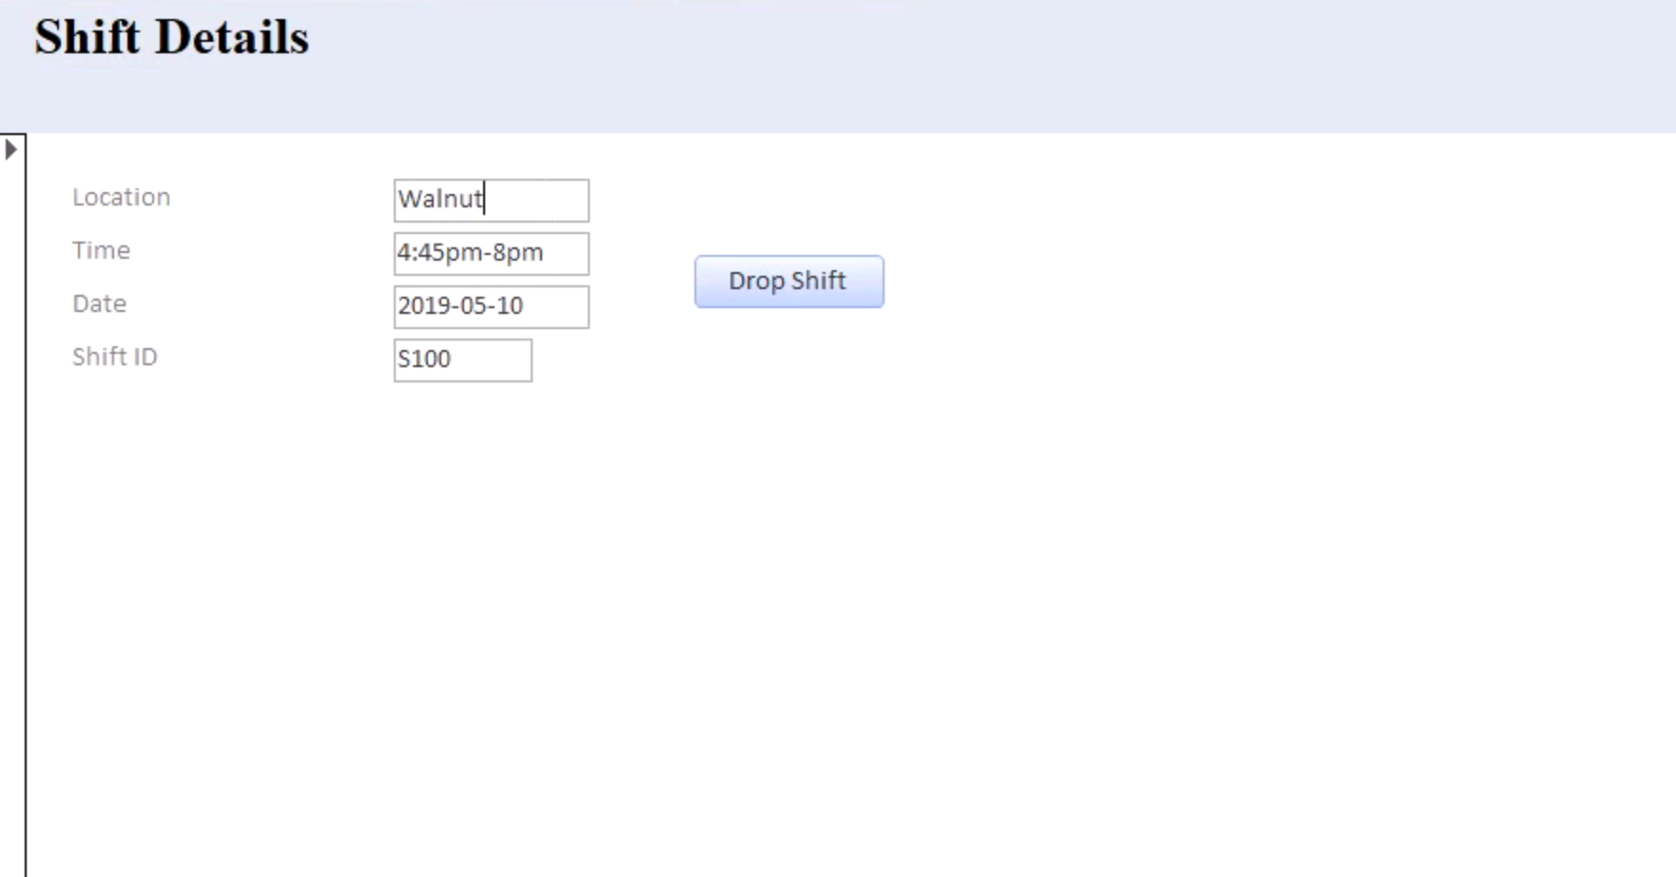
FORMS
Shift details

Slide 14
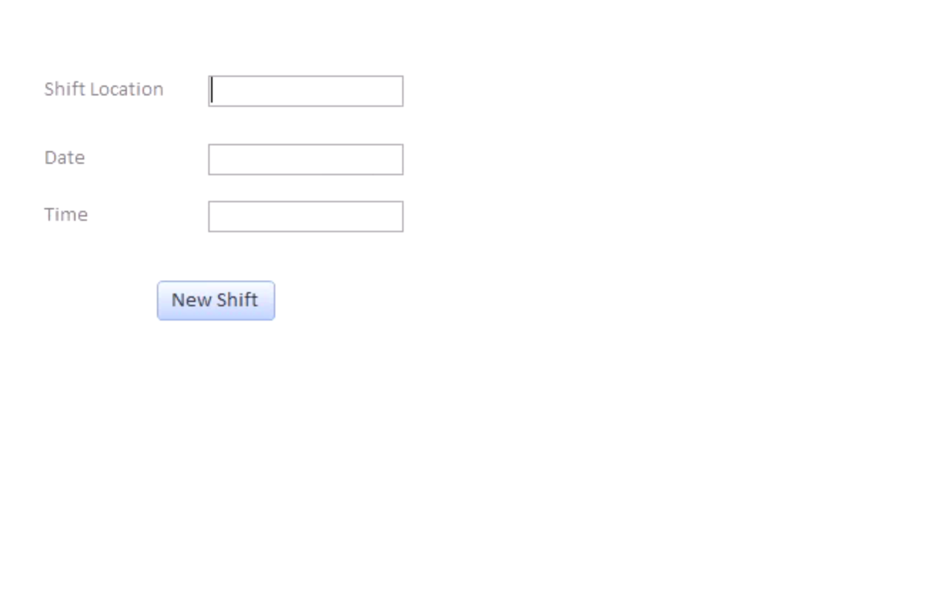
FORMS
Add new shift

Slide 15
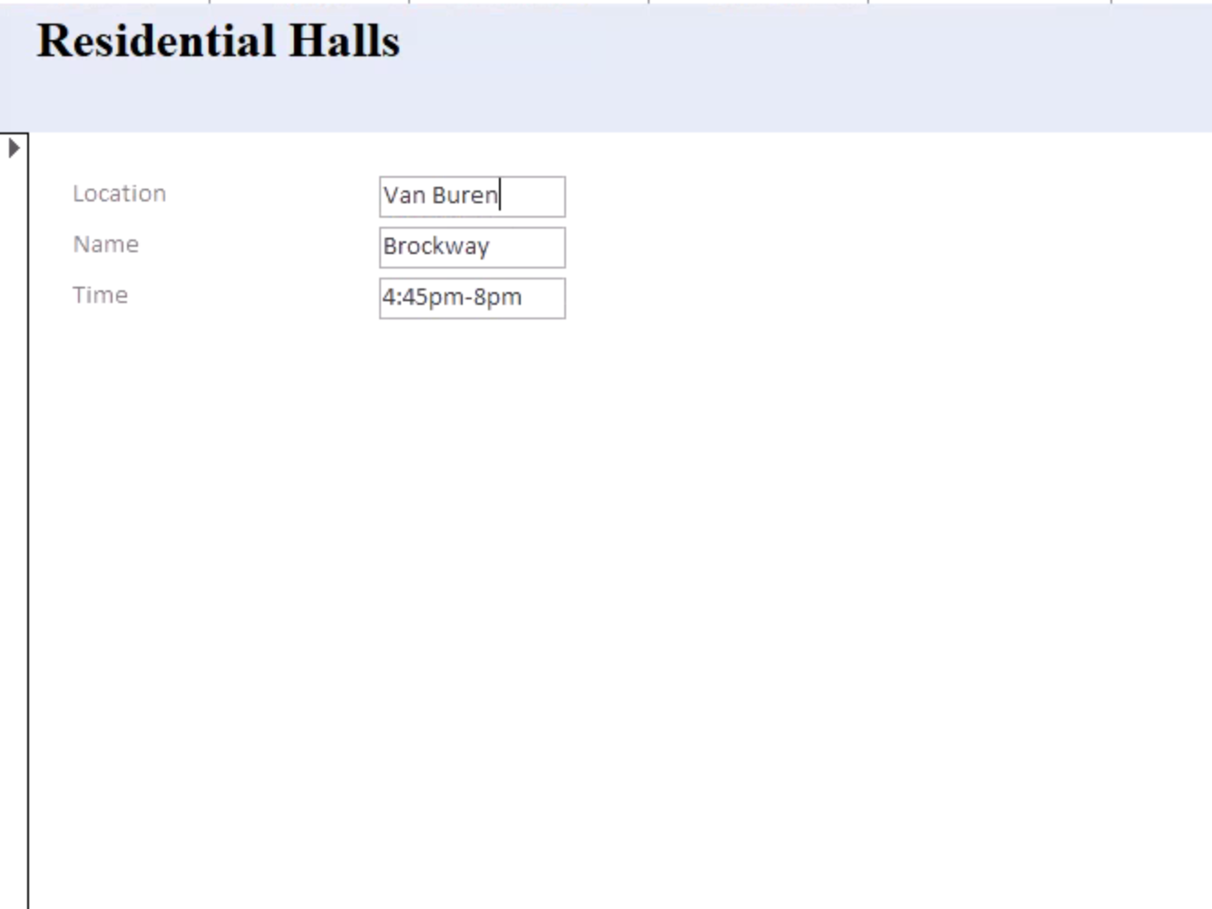
FORMS
Residential Halls

Slide 16
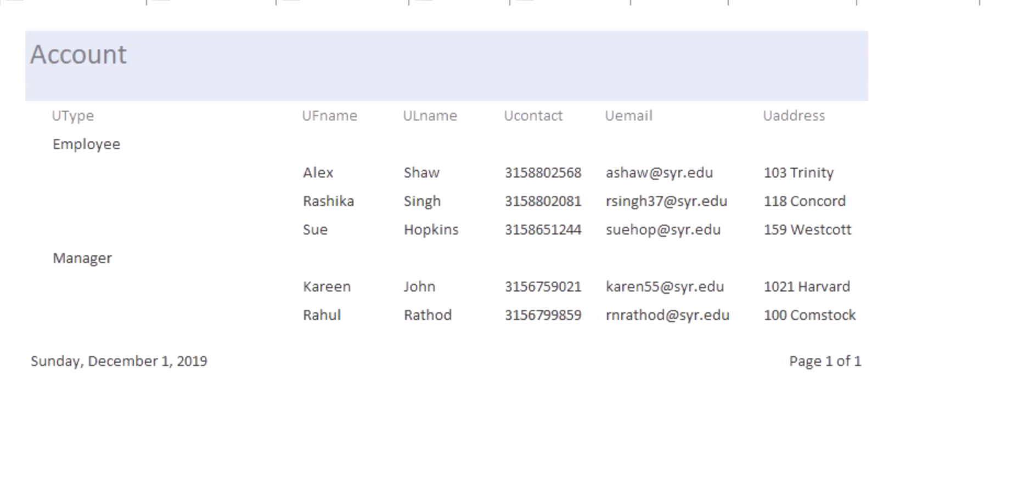
REPORTS
Displaying grouping by managers and employees

Slide 17
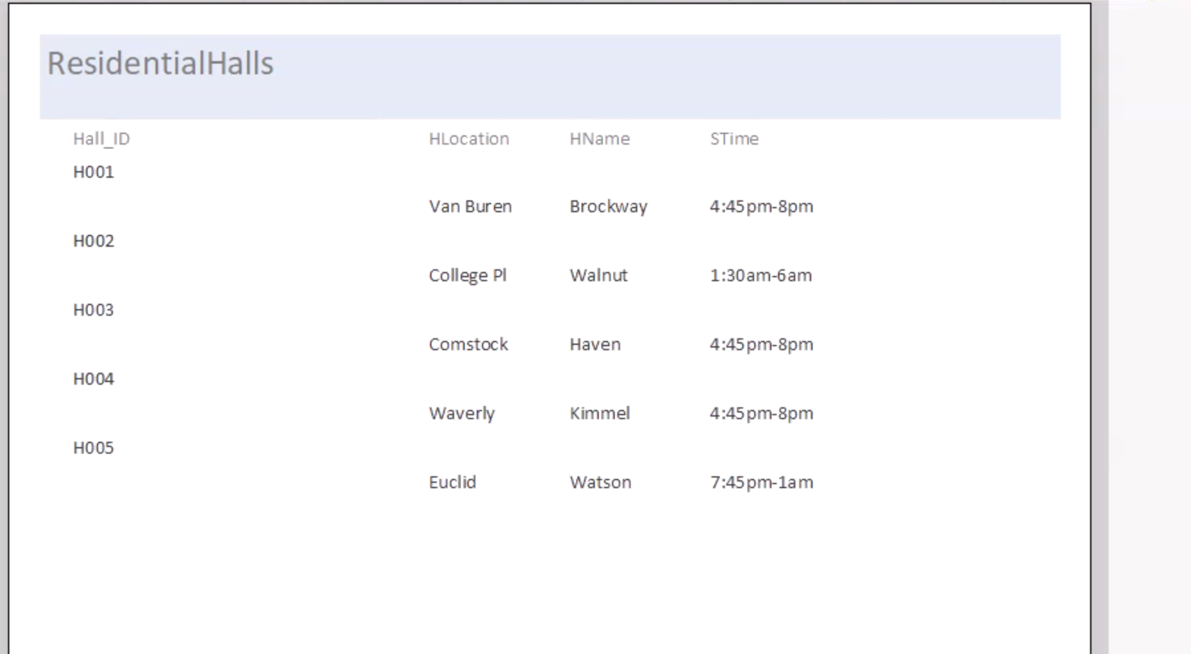
REPORTS
Displaying the list of shifts arranged by hall ID

Slide 18
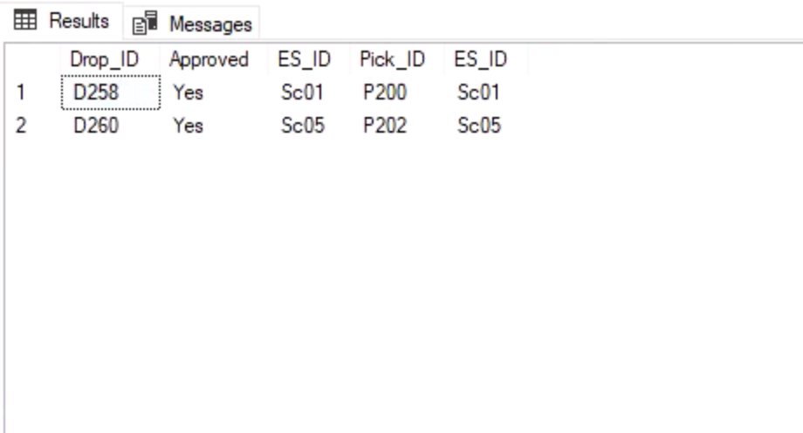
TRIGGER
Add a shift to the shift schedule after it is approved by manager

Slide 19
SUMMARY
The project is a centralized database which can be accessed by both the managers and employees
The manager can supervise over all the employees and the employee can use the application to drop the shifts and pick shifts which are dropped if he is free
The entire process of management of shifts can be done efficiently using the database

